Slide 1
www.MINEPORTAL.in
ONLINE TEST SERIES FOR
DGMS COAL/METAL FIRST/SECOND CLASS EXAM
GATE MINING EXAM
OVERMAN EXAM TEST
MINING INSPECTOR EXAMS
COAL INDIA MTs & OTHER PSUs EXAMS
FREE STUDY MATERIAL & VIDEO LECTURES
MINING JOBS NOTIFICATIONS
www.mineportal.in Call/Whatsapp-8804777500 www.fb.com/mineportal.in

Slide 2
COMPUTER TECHNIQUES FOR OPTIMISATION OF CYCLE OF OPERATION

Slide 3
INTRODUCTION
The production cycle employs unit operations which are normally group in two functions: rock breakage and materials handling. Breakage includes a variety of mechanism but in rock is usually accomplished by drilling and blasting.
Handling generally encompasses loading or excavation and haulage (horizontal transport), with optional hoisting (vertical or inclined). Thus the basic production cycle in mining consists of these unit operations:
Production cycle = drilling + blasting + roof supporting + loading + hauling

Slide 4
Softwares used for optimisation of cycle of operation:
TORA
MINESCHED
MICROSOFT EXCEL
Basically, mine scheduling is done using MINESCHED.

Slide 5
Mine Scheduling
MineSched provides complete long-term and short-term schedules.
MineSched has target-based scheduling algorithms to automatically create a sequence that meets your targets .
Create schedules that meet quality and strip ratio targets.
Accurately define haul routes and report truck hours and truck fleet requirements.
Schedule activities such as drilling, blasting, and pit in-filling.

Slide 6
MICROSOFT EXCEL REPORTS AND CHARTS
MineSched’s reporting functions provide a clear insight into a schedule’s period by period grade, tonnes, equipment requirements, and economics.
Any combination of data from a MineSched schedule can be exported to Microsoft Excel, where it can be formatted and shared with other applications.
Define a custom report format and use pre-created templates.
Obtain a detailed understanding of the schedule which can easily communicate the results to management and other stakeholders.

Slide 7
VISUALISE MINE SCHEDULES WITH 2D AND 3D GRAPHICS
With MineSched’s internal visualisation capabilities, schedules can be viewed in two or three dimensions, allowing schedules to be clearly communicated and validated. MineSched’s 3D Display allows users to:
View the material that will be mined as a 3D solid
Interrogate each item on screen to display tonnage and grade attributes.
Colour items on screen to show period and production data.
Animate activities by using alternate geometries.

Slide 8
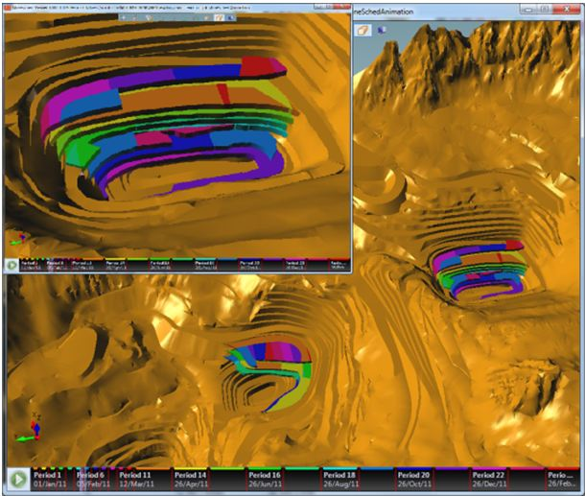

Slide 9
Shovel dumper dispatch algorithm Ant colony optimization
Ant colony optimization has been successfully implemented in several combinatorial optimization problems like vehicle routing problem.

Slide 10
Bissiri 2003, had made an attempt in generating a response function that is dependent on the shovel stimulus to particular dumper, ability of dumper to respond to shovel and status of dumper, whether empty or loaded.
The response function rij can be expressed as:

Slide 11


Slide 12
Si(t) = demand of shovel i for dumpers
Θij(t) = ability of dumper j to respond to the demand of shovel i,
N = total number of shovels during operations at faces
M = total number of dumpers in operation.
n>1 = steepness.

Slide 13
Vogel’s approximation /penalty method
ALGORITHM
Step 1:First find penalty for each row and column .
Step 2:After calculating penalty look for the row/column with maximum penalty.
Step 3:Then eliminate that row/column if demand is fulfilled or supply is over.
Step 4:Then again calculate penalties and select the max. penalty row/column and continue in the similar manner.

Slide 14
Transportation Algorithm
Step 1:After determining an initial feasible solution by using any of above discussed methods ,enter the solution in the upper left corners of the basic cells.
Step 2:For all the basic varibles Xi,j solve the system of equations:
Ui+Vj=Ci,j
Assigning zero values for Ui or Vj,where the max.allocation done in particular row or column.
Step 3:Compute the net evaluations for:
Dij=Ci,j-(Ui+Vj)
Step 4:Examine the sign of each Dij;
1)If all Dij>0 then solution is optimum.
2)If any Dij=0 then solution is optimum but there is an alternative solution exist.
3)If any Dij <0 then follow the step 5
Step 5:A loop will start from the allocation cell which is having maximum negative Dij value.
Make arrow from that cell only in horizontal or vertical direction and complete the loop by making arrow and maintaining equal no. of +ive and –ive sign(-ive and +ive signs are assigned at the cells of the closed loop starting with a –ive sign at the 1st cell of loop).

Slide 15
Steps for Transportation problem analysis in Microsoft Excel
Copy the problem in Microsoft excel.
Add one title ‘total’ below Demand and similarly add one title of ‘total’ beside Supply.
In the new column give the function of sum by writing ‘=SUM’ and select the first row of constrains and hence copy this continue the same function for remaining elements of the column.
Now repeat the same process for new row.

Slide 16
These steps were done to sum the units for comparison with Demand and Supply in later steps.
Now copy the full problem again at a new position(leaving the new row and column) and delete the constrains of the old problem.
Now name one cell as ‘total cost’ and input the function ‘=SUMPRODUCT’ and select the empty cells and constraints cell(copied one). This will provide us the cost by multiplying units and our provided constraints.
Now open solver and in ‘Target cell’ select the total cost cell and give the function of ‘min’.
In ‘By changing cells’ select the empty cells and in ‘Reference’ select our constraints.
Now click on add constraints and select, demand cells and in by reference cells, select total(new row) with ‘>=‘
Similarly add another constraints of supply with ‘<=‘.

Slide 17
Then click on options and select ‘Assume Linear Model’ and ‘Assume Non-negative’.
Then click on ‘Ok’.
Click on Solve. We will get the desired units and least cost.
The above steps are explained in attached video.

Slide 18
Presented by:
11108EN074 To 11108EN085

